Slide 1

BusyBee
Connect with your kids and make parenting a breeze with BusyBee

Slide 2

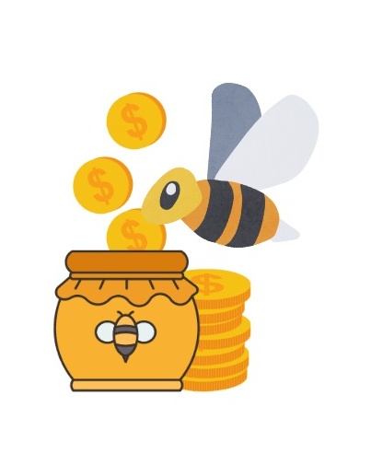
Team Poize
Category – Open Innovation

Slide 3
Agenda
1
2
3
4
5
Introduction
Primary Goals
Areas of Growth
Timeline
Summary

Slide 4
The Problem:
70% of families lose their generational wealth by the 2nd and 90% by the 3rd
^{- NASDAQ}
Money is not considered an important topic to discuss as they think it promotes entitlement in children thereby also refusing children have access to disposable income like pocket money.
Children later in life have little to no financial knowledge or discipline to spend money wisely and this leads to wild spending and the outflow of cash increases more than the influx.
Due to rise in Living costs dual income households are on a rise where both parents work to earn a living leaving the kid either alone or with a caretaker(grandparents or babysitters).
Parents on the other hand are at times not aware of what should they look forward in their child’s interest.

Slide 5
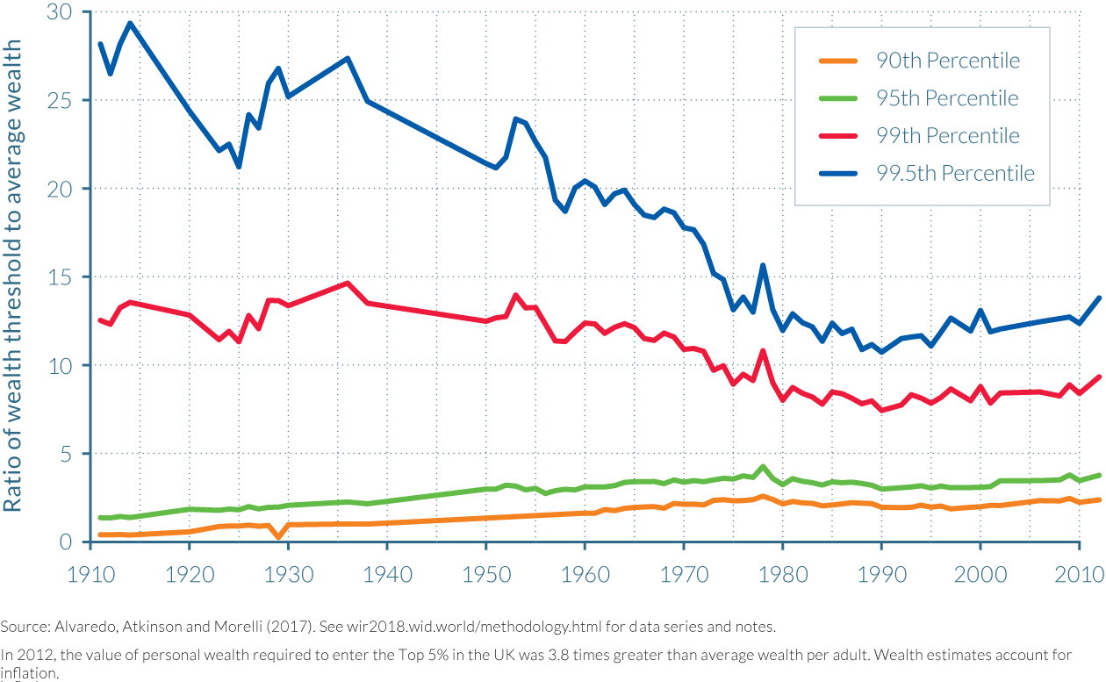
Wealth Problems

Slide 6
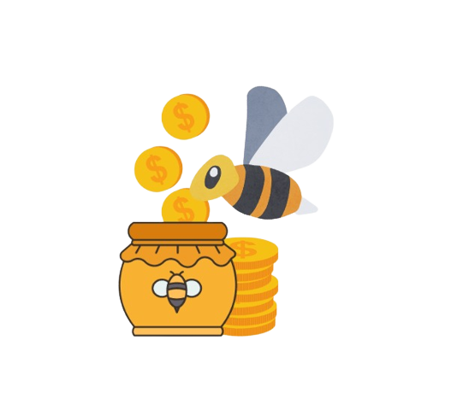
Role of BusyBee
Inculcate Financial Literacy and Good Habits by digitalizing parenting in a healthy way

Slide 7
The more you learn The more you earn
“
”

Slide 8
Our Solution
BusyBee works by rewarding children with honey(virtual currency) which can be used to redeem reward determined by the parents
We created BusyBee as solution to help inculcate discipline and good habits in children using positive reinforcement.
Parents can provide task for the children to complete which rewards them with honey after being verified by the parent.
The child can then use the honey harvested by him to redeem rewards preset by the parent.

Slide 9
Interface :
Parent Side App
Child Side App

Slide 10

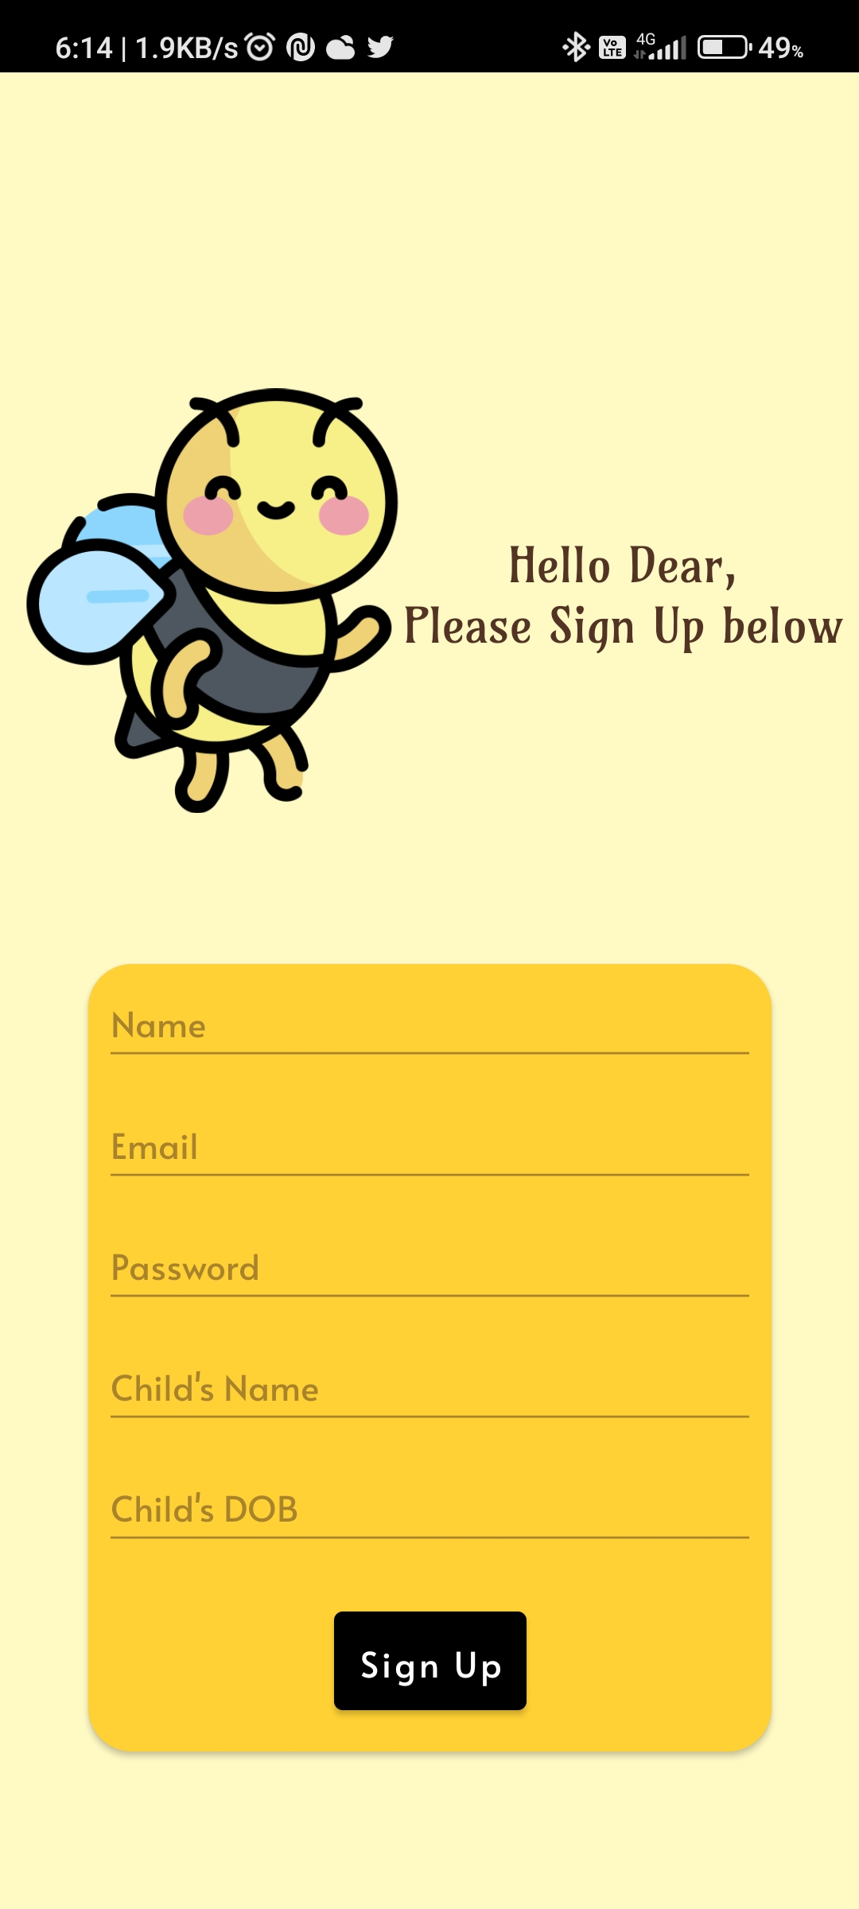
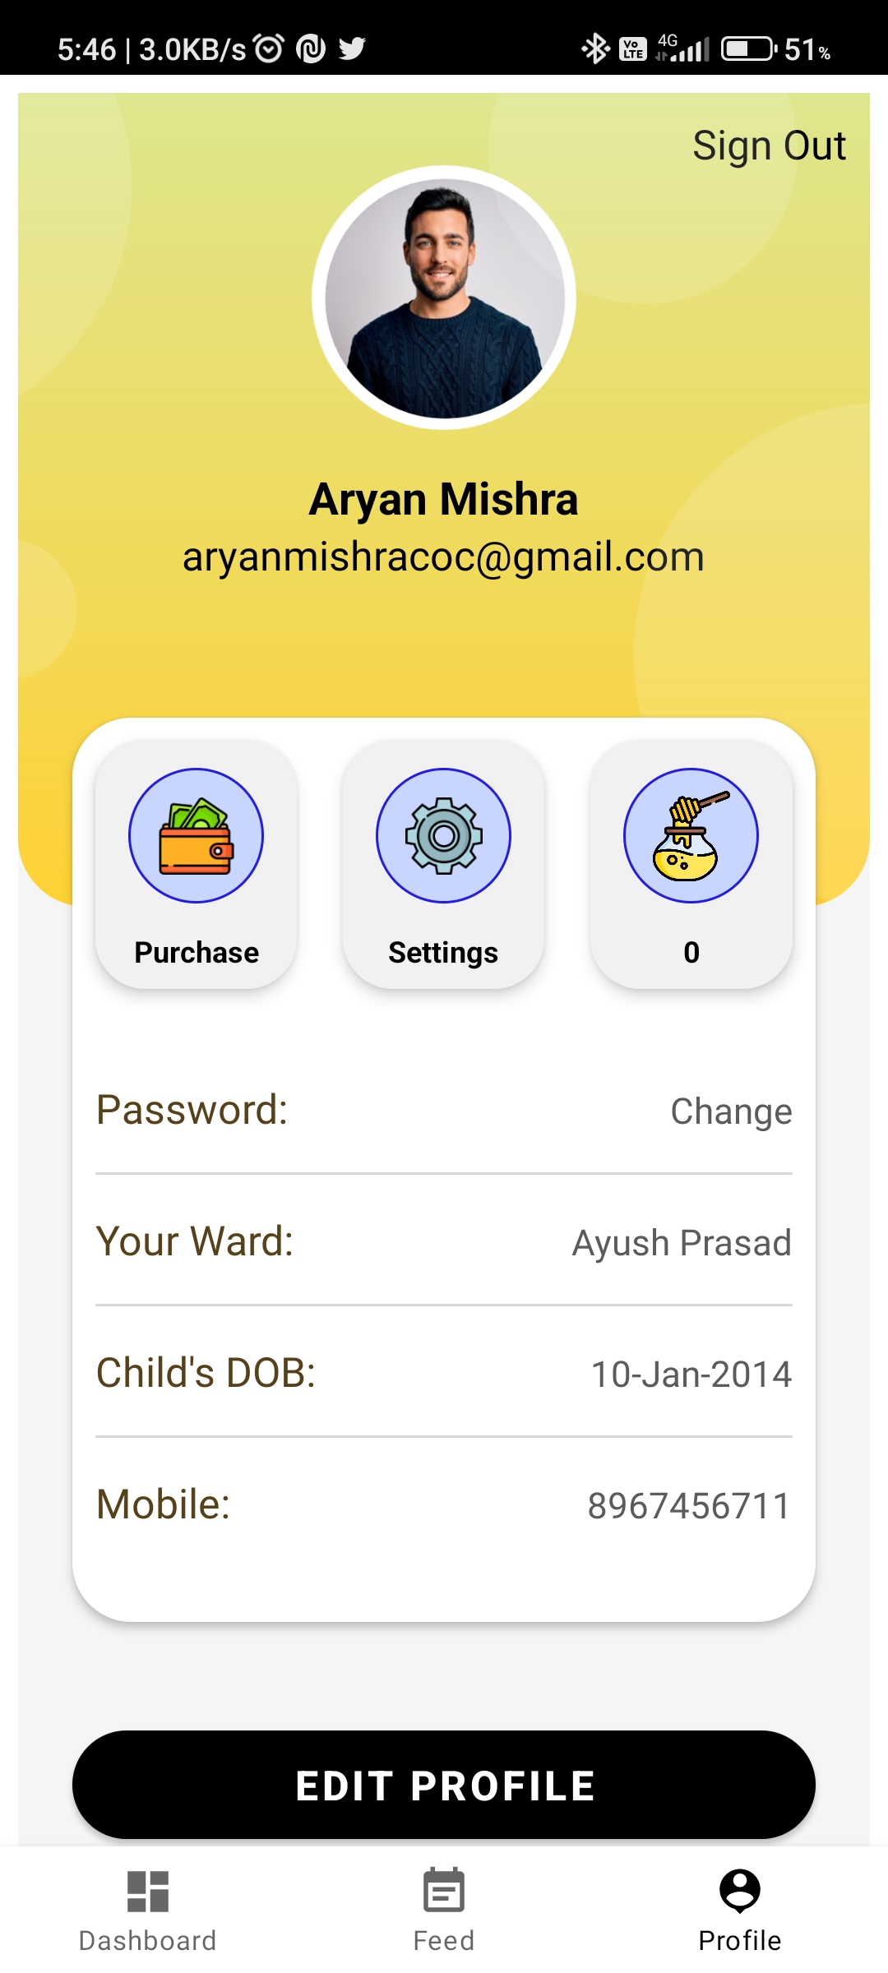
Parent Side App
Login or Create an Account
Enter credentials
Your Parent-Child profile

Slide 11
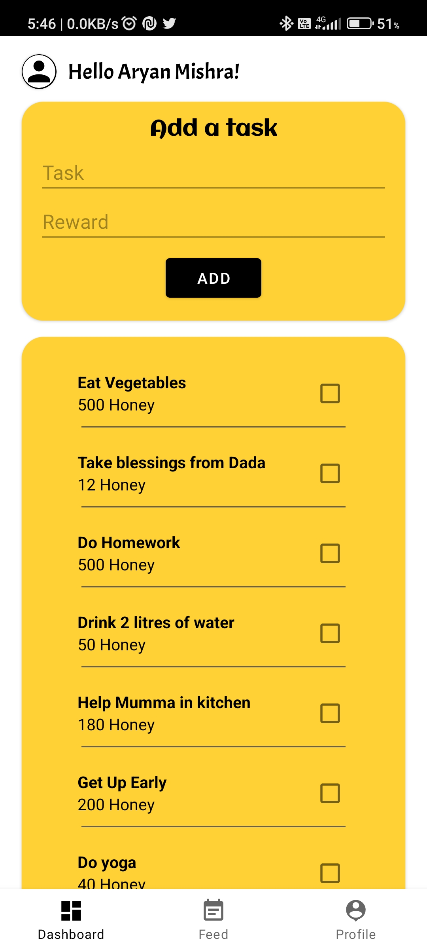
Add tasks for you kids and
set rewards.

Slide 12
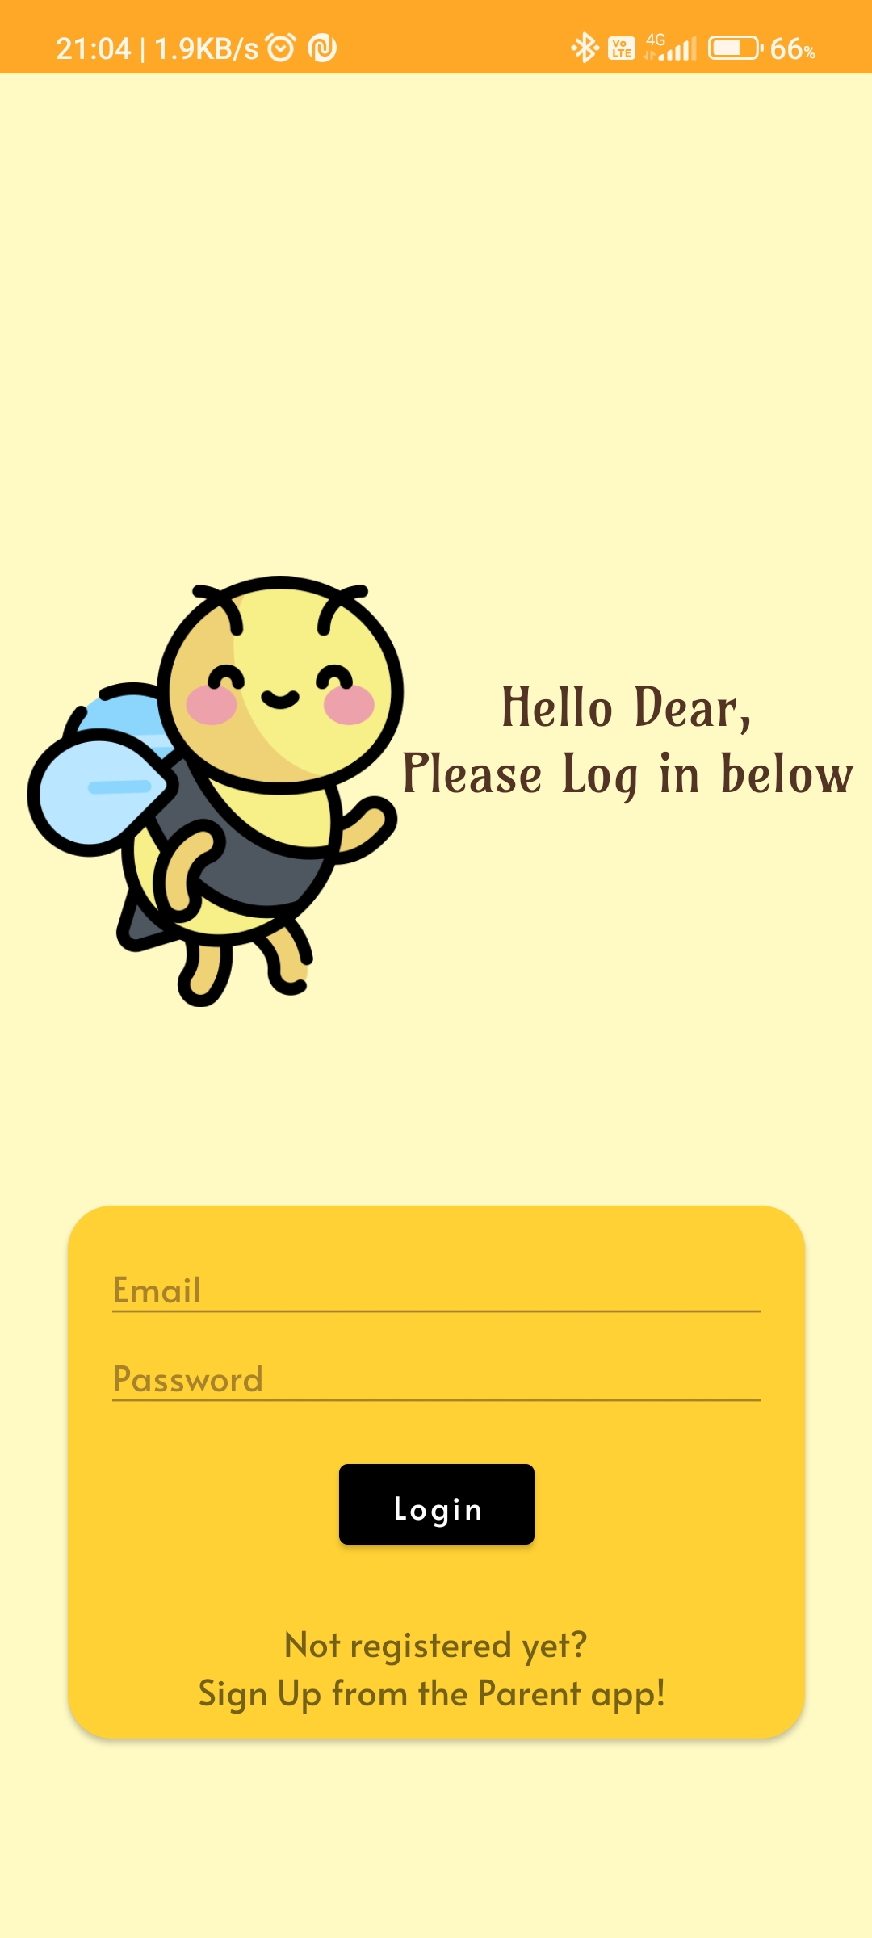
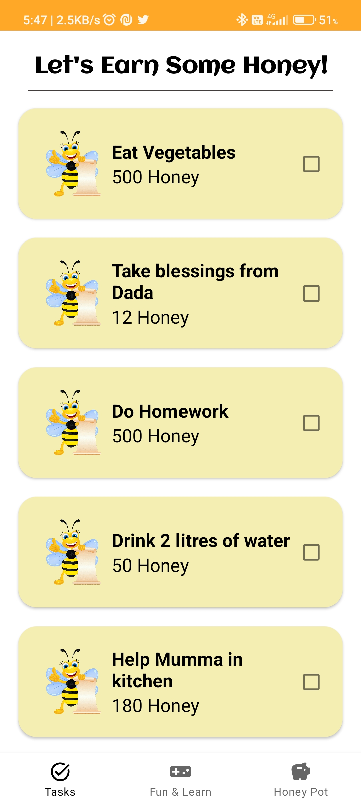
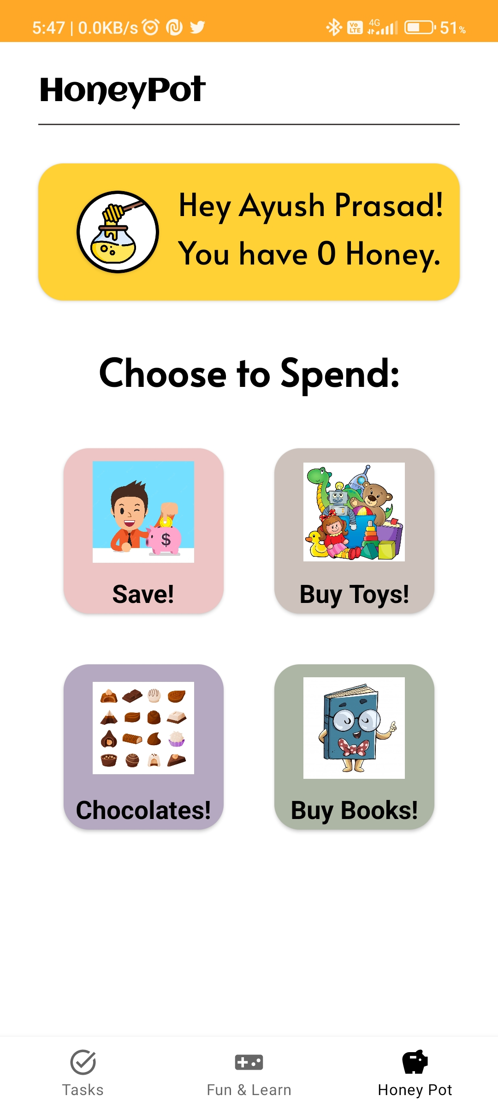
Child Side App
Sign into the Child app after setting up Parent App
Complete tasks and harvest honey
Dashboard with the amount of honey harvested

Slide 13
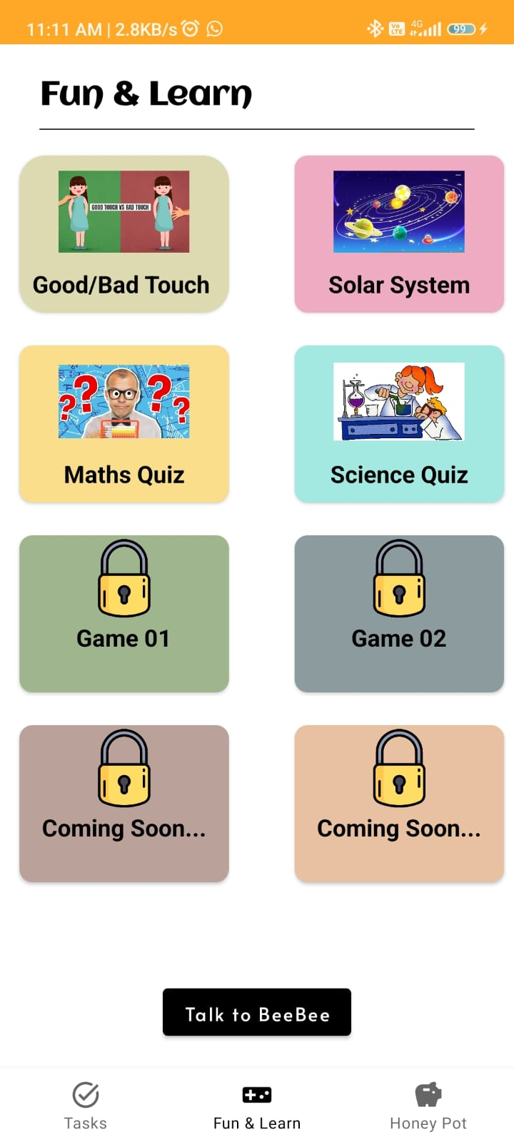
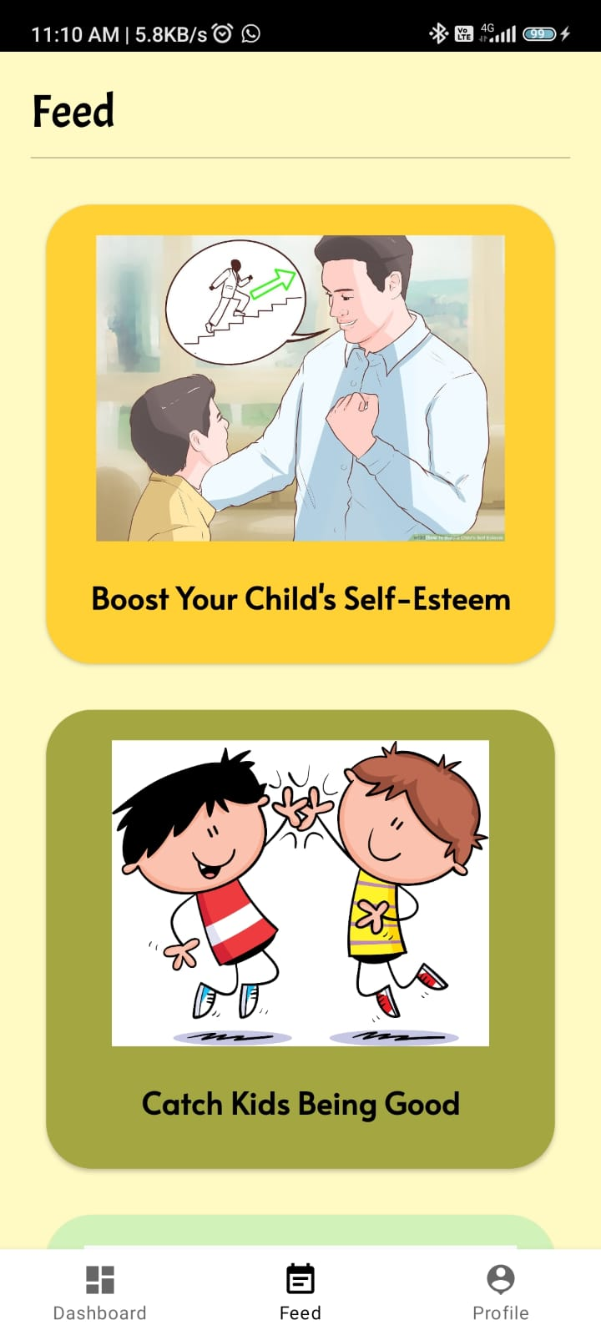
Child’s learning & Parenting Feed
Kids harvest honey by learning
Parenting advisory by reliable content

Slide 14
Future prospects​
Use of AI & ML
Fairly large market
The truest-friend for Kids
Monitor Child activities and recommend alike informative and educational content.
Let the parents know which career prospects might lie ahead for the kid. ​
Millenials, who have turned parents of the age group 6-12 are usually working professional who aren’t able to spend ample amount of time with their kids.
The parenting tips and engagement they can develop this way would be lovable
The idea to integrate a chat and talk partner for kids who responds to kids’ secrets from school.
This is to ensure that kids aren’t indulging in malicious activities or even being bullied at school.

Slide 15

Summary
This app is our approach as an Ed-Fin-Tech app to digitalize parenting of the new gen kids and new gen parents as well as inculcate good habits, moral values and importantly financial literacy in kids at the right age.

Slide 16

Thank you
Team Poize:
Aryan
Shreyas
Ayush
Prachi

